Slide 1
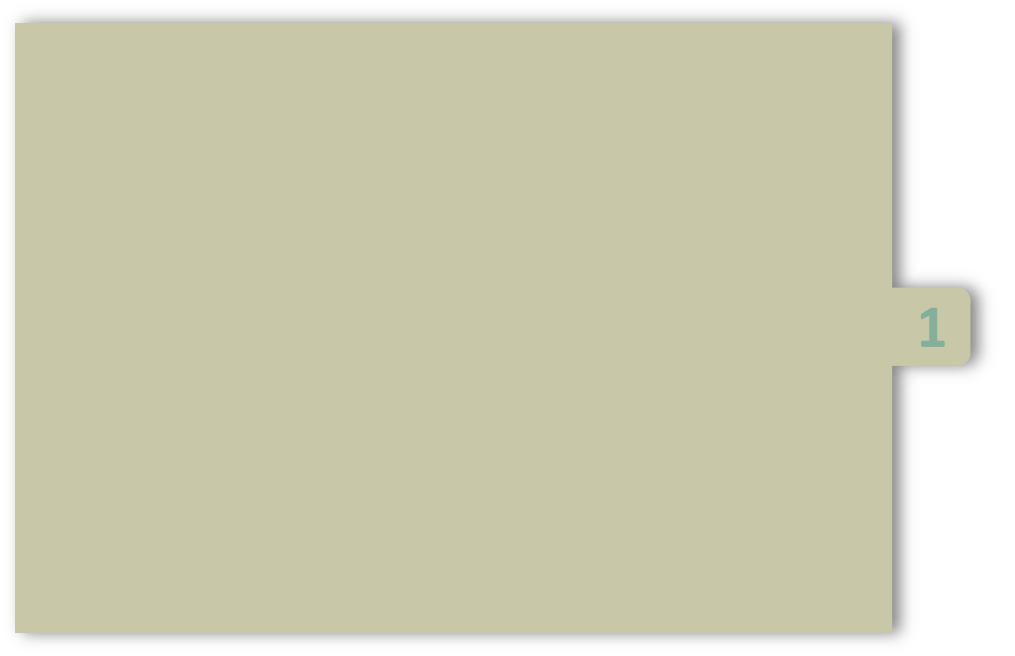



UNIT-1
Introduction to Programming:
Introduction to components of Computer system
Algorithm
Flow chart
Program development steps
C Tokens
Structure of C program
Basic I/O statements
Operators
Operator precedence
PRESENTED BY
Dr. Jagadeesh Kakarla
CSE DEPARTMENT
IIITDM Kancheepuram

Slide 2
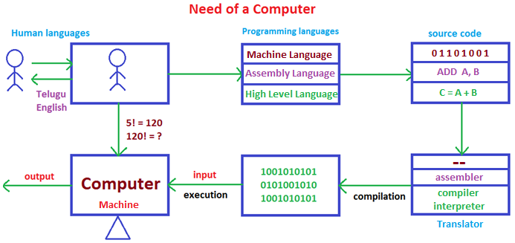

Slide 3
Definition of Computer
Definition 1 :
A computer is an electronic machine that accepts data, stores and processes data into information.
Definition 2 :
A computer is a machine that accepts data as input, processes that data using programs, and produce the output as information.
When the data is entered into the computer, the computer processes the data to produce information which is output.
Example, you enter 2+2 into the computer as data, the computer processes it and the result is 4 which is information.

Slide 4
Components of a Computer System
There are five basic components of the computer which help in making this processing of data easier and convenient.
There are five basic components which include:
Input Unit
Output Unit
Memory Unit
Control Unit
Arithmetical and Logical Unit

Slide 5
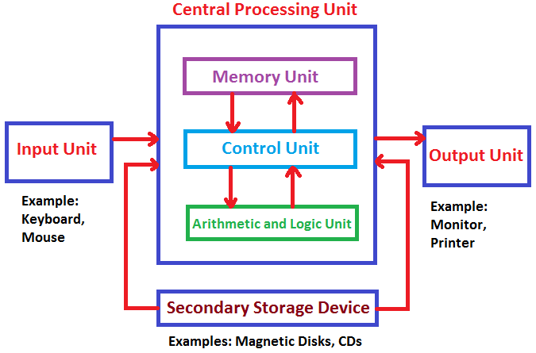
Components of a Computer System

Slide 6

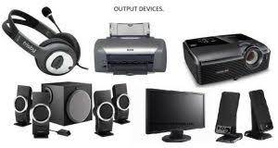
i)Input Unit
These components help users enter data and commands into a computer .
Input data can be in the form of numbers, words, actions, commands, etc.
The main function of input devices is to directly enter the data into computers.
ii)Output Unit:
After processing of data, it is converted into a format which humans can understand.
After conversion, the output units display this data to users.
Example
Key board,Mouse,Micro phone
Example
monitors, screens, printers and speakers

Slide 7
iii)Central Processing Unit (CPU):
The Central Processing Unit (CPU )is the main processing unit of the computer.
It consists of three major components those are:
Memory Unit
Control Unit
Arithmetic and Logical Unit
It is also known as the “Brain of Computer” and no action can be conducted by a device without the execution and permission of the Central Processing Unit.

Slide 8
a) Memory Unit:
When we enter the data into the computer using an input device, the entered information immediately gets saved in the memory unit
Memory is very much like our brain as it is used to store data and instructions
The large memory is divided into a number of smaller portions called the cell. Every cell/ location has a unique address and a size.
Two types of memories are:
Primary Memory
Secondary Memory

Slide 9
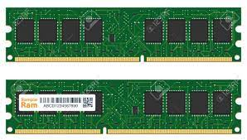
Primary Memory(RAM)
Primary memory is also called internal memory. Primary memory data is directly accessed by the processing unit.
Random Access Memory(RAM) is generally known as a main memory of the computer system.
RAM is called temporary memory or cache memory.
The information stored in this type of memory is lost when the power supply to the PC or laptop is switched off.
RAM is a read-write memory. Used to store the data that has to be currently processed by CPU temporarily.
It is volatile memory.

Slide 10
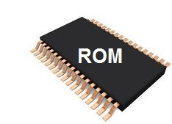
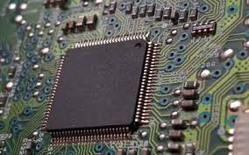
Primary Memory (ROM)
The data in ROM can only be read by CPU.
It stores the instruction required during bootstrap of the computer.
It is non-volatile memory.
Data in ROM cannot be modified. ROM is a permanent type of memory.
Its content is not lost when the power supply is switched off.
The computer manufacturer decides the information of ROM, and it is permanently stored at the time of manufacturing which cannot be overwritten by the user.
Notes:
‹#›

Slide 11
b) Arithmetic & Logical Unit(ALU):
As the name suggests, all the mathematical calculations or arithmetic operations are performed in the ALU of the CPU.
It can also perform actions like a comparison of data and decision-making actions.
c) Control Unit:
This is the core unit which manages the entire functioning of the computer device.
The Control Unit collects the data entered using the input unit, leads it on for processing and once that is done, receives the output and presents it to the user.
Basically, It issuing signals to execute the data and then finally retrieving the data.

Slide 12
Secondary Memory
Secondary memory is also known as a Backup memory or Auxiliary memory or External memory.
Secondary memory is permanent.
All secondary storage devices which are capable of storing high volume data is referred to secondary memory.
It's slower than primary memory. Secondary memory data cannot be accessed directly by the processor.
Example
Hard disks, Floppy disks, Pen drives, Memory Cards.

Slide 13
Algorithm
Definition :
“An algorithm is the step-by-step method of performing any task”.
“An algorithm is process of solving the problem step by step”.
All algorithms must satisfy the following criteria.
Input : Ever algorithm must take one or more inputs.
Output : Ever algorithm must produce at least one output.
Definiteness : Each step must be clear and with out any confusion.
Finiteness : The algorithm terminates after a finite number of steps.
Effectiveness : Every step must be easily converted to program.
Generality : Algorithm must be a general.

Slide 14
Types of Algorithm
Algorithms can be divided in three basic categories as listed below
Sequence
Selection
Iteration
i)Sequence: A series of steps that we perform one after the other without any break.
ii)Selection: Making a choice from multiple available options. A selection statement generally takes the form.
iii)Iteration: Performing repetitive tasks.

Slide 15
Types of Algorithm
i.Sequence Algorithm
Ex:Write an algorithm for addition of 2 numbers
Step 1: Start
Step 2: Read a,b values .
Step 4: Add a and b and store result to c.
Step 5: Write c
Step 6: Stop
i.Sequence Algorithm
Ex:write an algorithm to find sum of n natural numbers
Step 1 : Start
Step 2 : Read n value
step 3 : sai <- (n*(n+1))/2
Step 4 : write sai
Step 5 : Stop

Slide 16
Types of Algorithm
ii. Selection Algorithm
ex:write an algorithm to find the given number is EVEN or ODD
Step 1: Start.
Step 2: Read n value.
Step 3: if (n%2==0)then goto step4
otherwise goto step5
Step 4: Write EVEN and go to step 6
Step 5: Write ODD
Step 6: S top
ii. Selection Algorithm
Ex:Algorithm to find largest of two numbers
Step 1: Start.
Step 2: Read a, b values.
Step 3: If a>b then go to step3
other wise go to step4
Step 4: Write a is Big and go to step 6
Step 5: Write b is big
Step 6: S top

Slide 17
Types of Algorithm
iii. Iteration Algorithm
ex:Write an algorithm to print EEE-B 4 times
Step 1:Start
Step 2:Write EEE-B
Step 3:Write EEE-B
Step 4:Write EEE-B
Step 5:Write EEE-B
Step 6:Stop
iii. Iteration Algorithm
while (condition)
--------------------------
--------------------------
end while
Repeat
--------------------------
--------------------------
until(conditon)

Slide 18
Why flowchart?
The best way to understand a problem is to draw pictures.
Pictures provide us with a more complete idea of the situation than a series of short word
However, pictures combined with text provide an extremely powerful tool for communication and problem solving.
Algorithms can be developed more quickly when a flow chart is built.
By seeing a flow chart one can know the operations performed and the sequence of these operations

Slide 19
Flowchart
Flowchart is a graphical representation of an algorithm.
A flowchart is a picture representation of the problem solving process.
A flowchart gives a step-by-step procedure for solution of a problem.
The flowchart shows the steps as boxes of various kinds, and their order by connecting the boxes with arrows.
Flowcharts use simple geometric shapes to represent solution

Slide 20







Symbol | Symbol Name | Purpose
 | Oval Start/Stop | Used at the beginning and end of the flow chart
 | Rectangle Process | Indicates processes like mathematical operations.
 | Parallegram Input/ Output | Used for denoting program inputs and outputs(Read and write).
 | Diamond Decision | Used for decision , where answer is usually Yes or No.
 | Arrow | Shows relationships between different shapes.
 | Circle On-page Connector | Connects two or more parts of a flowchart.
 | Double sided Rectangle | A double lined rectangle is used at a point where a subprogram is used.

Slide 21
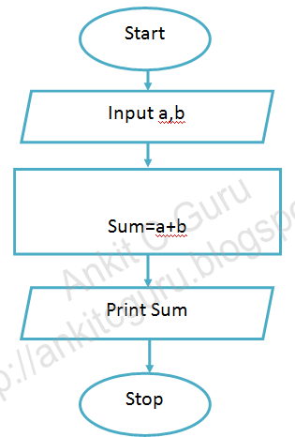
Example Algorithm and Flow chart
algorithm
step1: start
step2:initialization a, b
step3: calculating sum=a+b
step4: print sum value
step5: stop

Slide 22
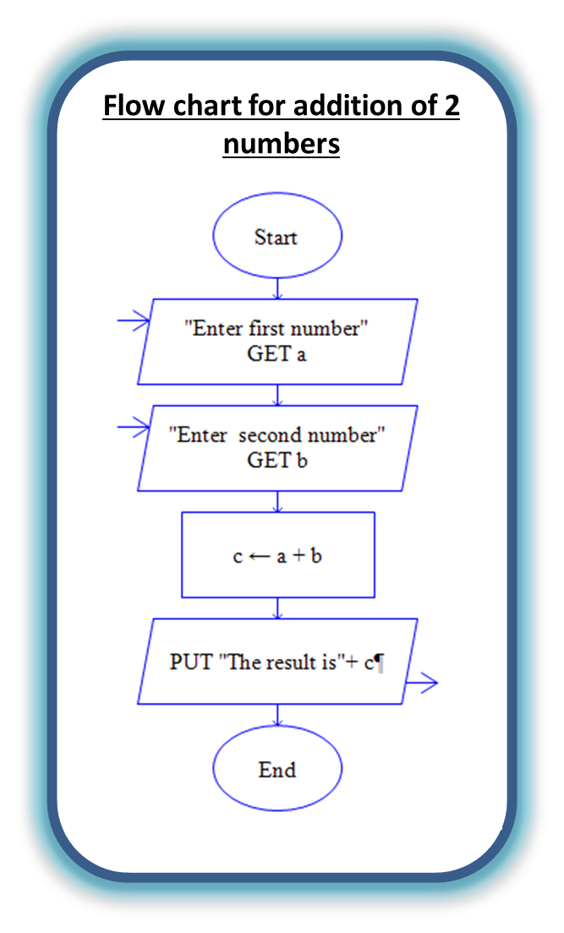
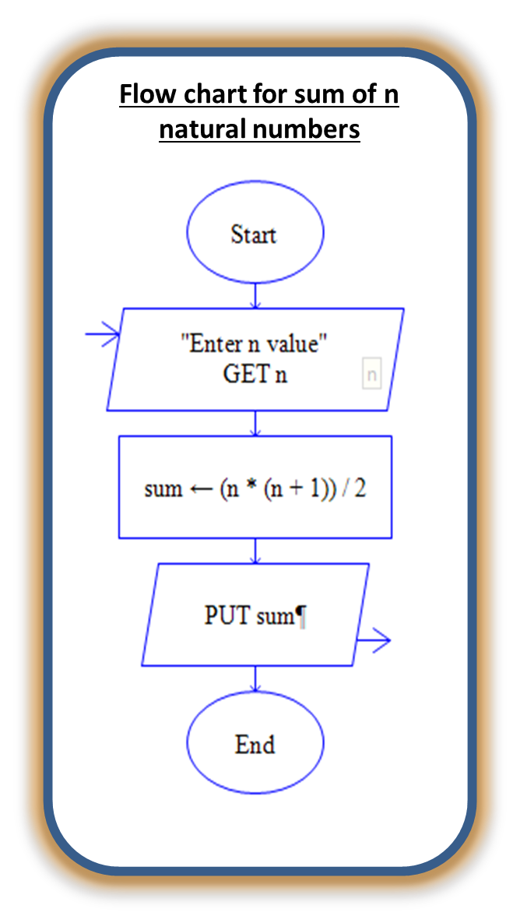
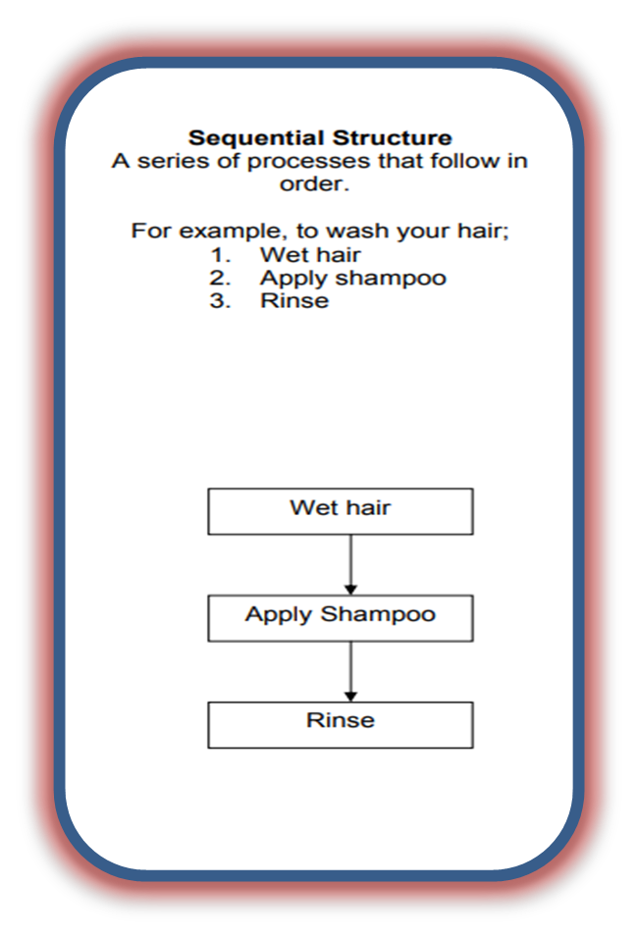
Notes:
‹#›

Slide 23
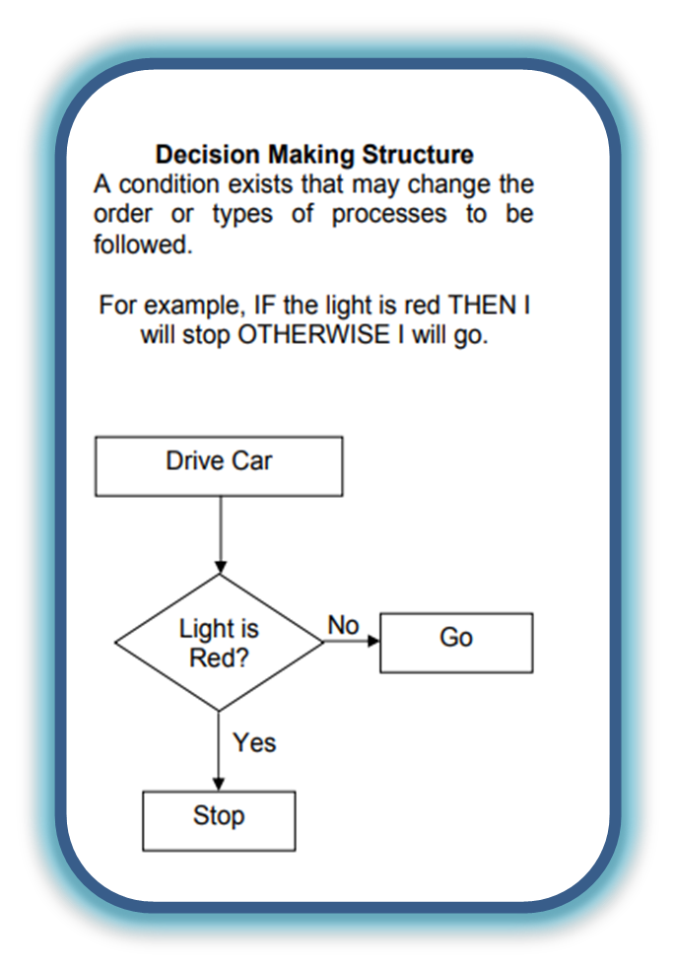
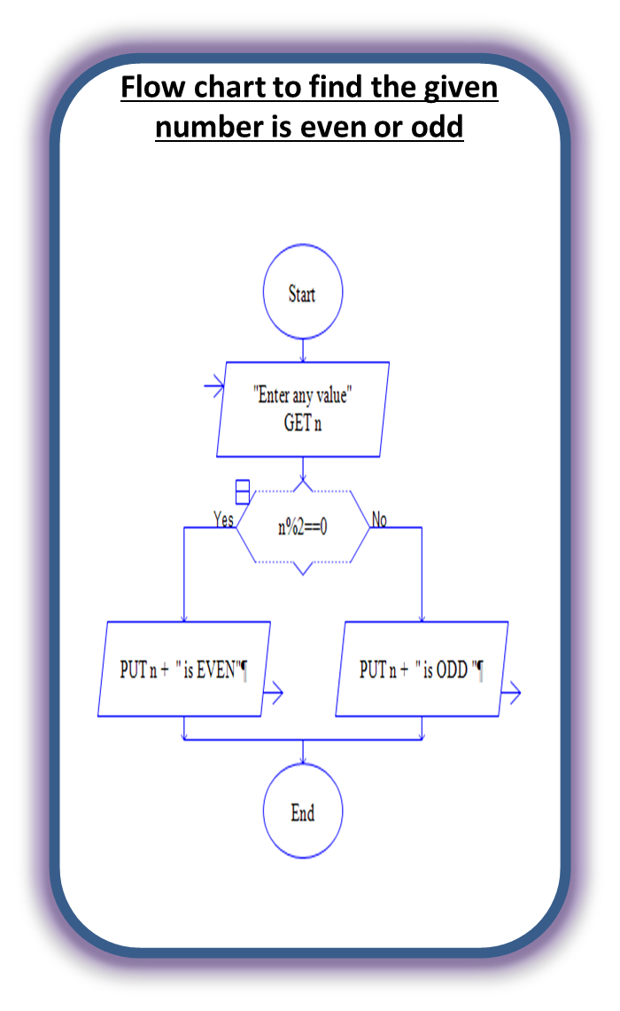
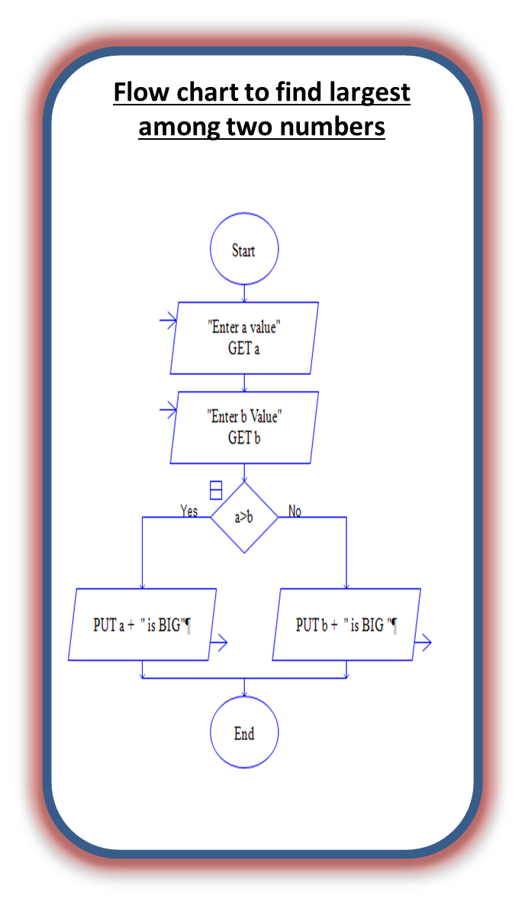

Slide 24
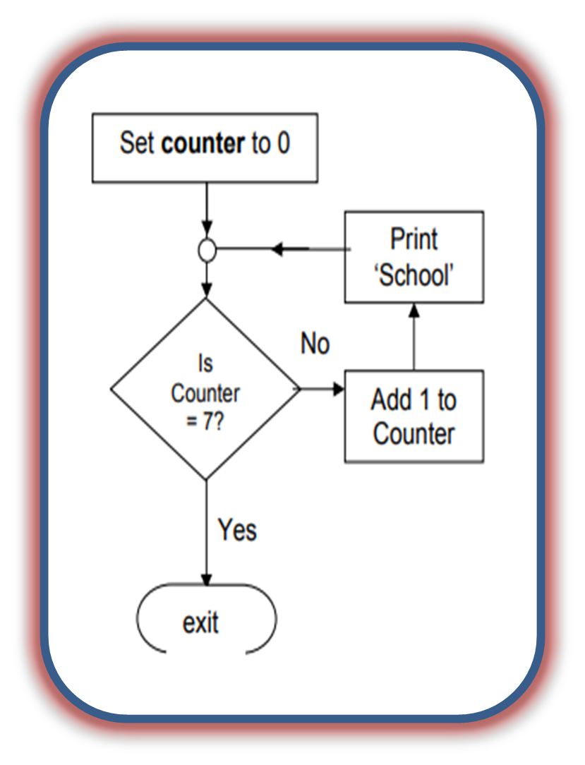
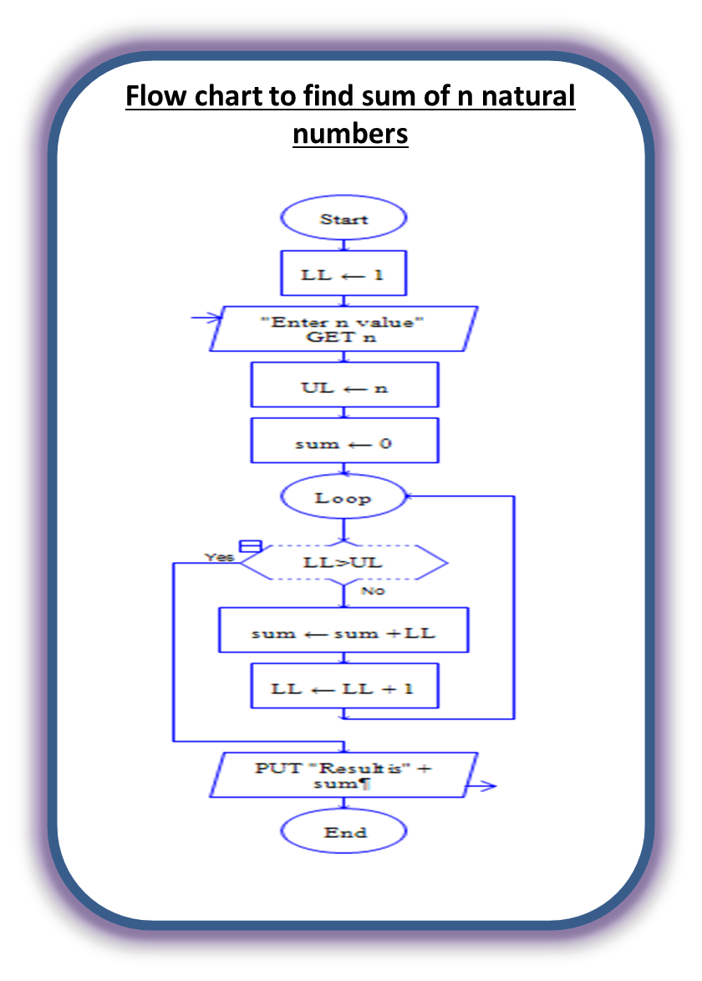

Slide 25
Program development steps
A C-program has to go through some phases for its successful execution.
There are 4 phases in program developing. They are ;
Editing phase
Compilation phase
Linking phase
Execution phase
Editing
Compiling
Linking
Executing

Slide 26
i. Editing phase
In editing phase, the C-program is entered or edited into a text editor.
After editing is completed, the file is saved with an extension “.c”.
I.e filename.c
The program that entered into the file is known as
“source program”.
The source program that we enter is in high level
language.
Extension
Extension is used to
differentiate file type.
C program - .c
Text file - .txt

Slide 27
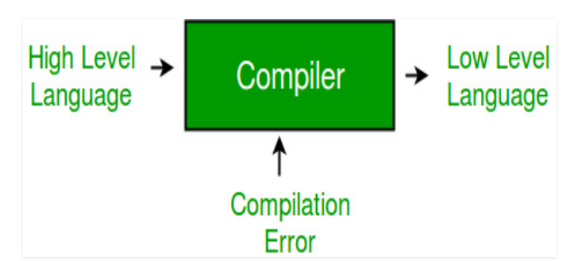
ii. Compilation phase
This phase is carried out by compiler.
The compilation phase cannot proceed until the source program is error free.
The compiler shows an error message if it encounters any error.
The error free source code is translated into object code.
The object code is saved with an extension “.obj”.
The object code that we saved is in low level language.

Slide 28
iii. Linking phase
In linking phase, other program files and functions which are required are attached to the program.
Linker, links all the files and functions with object code under execution.
Storage of linker files and functions is depended on the compiler.
Linker are 2 types. They are;
Pre-defined
User defined
Printf()
Stdio.h
Sqrt()
Math.h

Slide 29
iv. Execution phase
In execution phase, the object code is loaded into memory and execution begins.
If the program contains any logical or data error, we will not get desires answer and there is a need to edit source program.
If the source program is edited again, then the entire process of compiling, linking and executing should be done again.
The error free executable file is saved with an extension “.exe”.
Object code executable file Output

Slide 30
System ready
Edit source program
Compile source program
Syntax error
Yes
No
Linking with
System library
Execute object code
Data error
Logical/data error
Logical error
No error
Correct output
Stop

Slide 31

Introduction to Programming
C programming language was developed in 1972 by Dennis Ritchie at bell laboratories of AT&T (American Telephone & Telegraph), located in the U.S.A.
The C language is a general-purpose, high-level language.
The C has now become a widely used professional language for various reasons.
Easy to learn
Structured language
It produces efficient programs.
It can handle low-level activities.
It can be compiled on a variety of computer platforms.

Slide 32
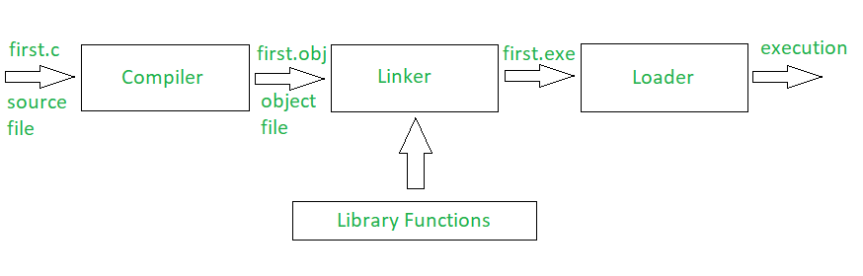
The C- Compiler
The source code written in source file is the human readable program.
It needs to be "compiled", converted into machine language so that your CPU can actually execute the program as per instructions given.
compiler will be used to compile your source code into final executable program.
Notes:
‹#›

Slide 33
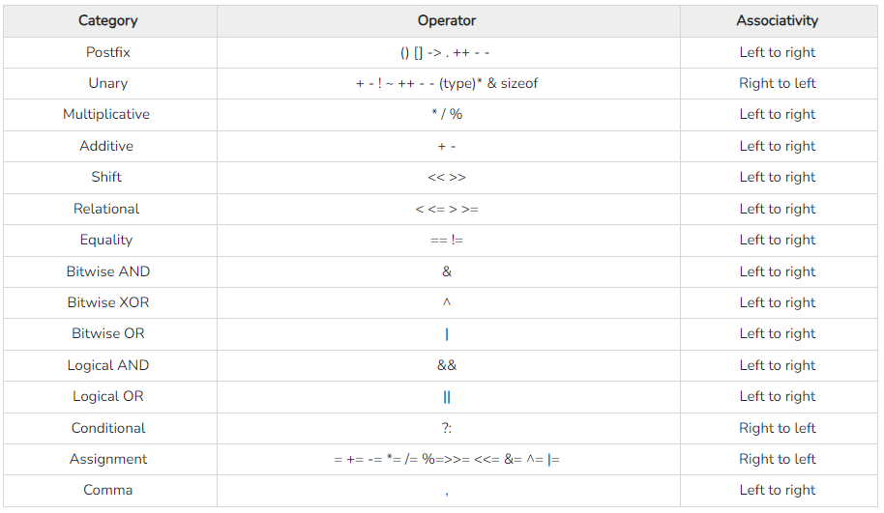

Slide 34

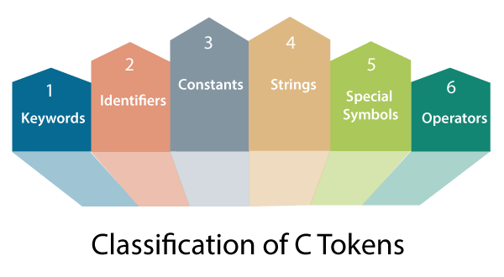
C-Tokens
TOKEN is the smallest individual unit in a 'C' program.
The compiler breaks a program into the smallest possible units (tokens) and proceeds to the various stages of the compilation.
A token is divided into six different types. They are:

Slide 35
1. Keywords
Keywords are pre-defined words in a C compiler.
Keywords have fixed meanings, and the meaning cannot be changed.
It is also known as Reserved words, System defined words, Pre-defined words, in-built words.
There are a total of 32 keywords in 'C'.
Rules
keywords can’t be used as variable name.
Keywords are written in lowercase letters
auto | double | int | struct | break | else | long | switch
case | enum | register | typedef | char | extern | return | union
const | short | float | unsigned | continue | for | signed | void
default | goto | sizeof | volatile | do | if | static | while

Slide 36
2. Identifiers
As the name says, identifiers are used to identify a particular element in a program
Identifiers are the user-defined names.
Example
Name of a variable, function, array, structure, union, file, pointer etc.
Rules
The first character must always be an alphabet or an underscore.
It should be formed using only letters, numbers, or underscore.
A keyword cannot be used as an identifier.
It should not contain any space character.

Slide 37
3. Constants
Constants refer to fixed values that the program can’t change the value during its execution.
These fixed values are also called literals.
we can define the constant variable by using below syntax:
when you try to change constant variable values after defining in C program, it gives error.
Syntax
const data_type variable_name;

Slide 38
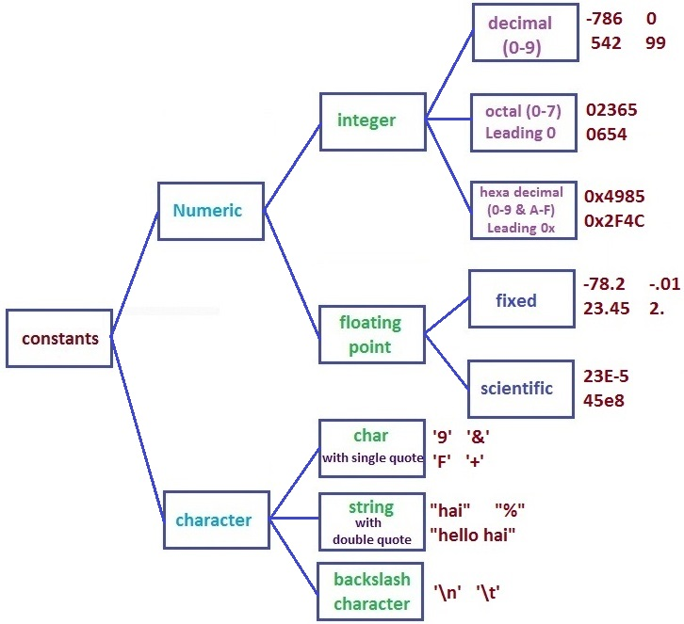
3. Constants

Slide 39

3. Constants
a) Integer Constants:
An integer constant must have at least one digit.
Octal constant : It consists of digits 0 to 7 and leading with 0.
Decimal constant : It consists of digits 0 to 9 and lead with any digit.
Hexadecimal constant : It consists of digits 0 to 9 and A to F and leading with 0x.
Note:
It must not have a decimal point. It can either be positive or negative.
No commas or blanks are allowed within an integer constant.
If no sign precedes an integer constant, it is assumed to be positive.
Ex: 040, 053
Ex: 976, 543
Ex: 0x2A5E

Slide 40

3. Constants
b)Real constants:
It must have a decimal point. It could be either positive or negative
If no sign precedes an integer constant, it is assumed to be positive.
The Real or Floating-point constants can be written in two forms: i. Fractional or Normal form ii. Exponential or Scientific form i. Fractional form: A real constant consists for a series of digits representing the whole part of the number, followed by a decimal point, followed by the fractional part. Valid Real constants (Fractional): 0.0 -0.1 +123.456 .2 2.

Slide 41

3. Constants
b)Real constants:
ii.Exponential form:
If the value of a constant is either too small or too large, exponential form of representation of real constants is usually used.
In exponential form, the real constant is represented in two parts. Mantissa - The part appearing before e, the mantissa is either a real number expressed in decimal notation or an integer. Exponent - The part following e, the exponent is an integer with an optional plus or minus sign followed by a series of digits.
Example
0.000342 can be represented in exponential form as 3.42e-4 7500000000 can be represented in exponential form as 7.5e9 or 75E8

Slide 42
3. Constants
c)Character constants:
A character constant is a single alphabet, a single digit or a single special symbol enclosed within single quotes.
The maximum length of a character constant is 1 character.
d)String constants:
A string constant is a single/multiple alphabet(s), digit(s), symbol(s) enclosed within double quotes.
The length of string constant is minimum 1 character.

Slide 43
3. Constants
e)Backslash Character Constants:
There are some characters which have special meaning in C language.
They should be preceded by backslash symbol to make use of special function of them.
list of special characters and their purpose.
Backslash_character | Meaning | Backslash_character | Meaning
\b | Backspace | \” | Double quote
\f | Form feed | \’ | Single quote
\n | New line | \\ | Backslash
\r | Carriage return | \a | Alert or bell
\t | Horizontal tab | \N | Octal constant
\v | Vertical tab | \XN | Hexadecimal constant
\? | Question mark | \0 | Null character

Slide 44
4. Strings
string in C programming language is actually group of characters which is terminated by a null character '\0'.
This null character indicates that string has ended.
Strings are always enclosed with double quotes(" ").
Ex:”AITAM”

Slide 45
5. Special symbols
Apart from letters and digits, there are some special characters in C, which will help you to separate code.
Each special symbol has a specific meaning to the C compiler.
Below are the various separators available in c language.
{ } -> Braces { and } for grouping zero or more statements into a block
( ) -> Parentheses ( and ) for specifying a precedence change in an expression.
[ ] -> Square brackets [ and ] for declaring/accessing an array element's value.
; -> Semicolon (;) for separating one statement from another.
, - > Comma (,) for separating variables and initializations in a variable declaration.
. -> Period/dot (.) for access a member of a structure.

Slide 46
Variable in C
Variable is the name of memory location
A variable is a storage area to hold data.
The value of the variable may get change in the program.
we can change value of a variable during execution of a program.
Rules
A variable can have alphabets, digits, and underscore.
A variable name can start with the alphabet, and underscore only. It can’t start with a digit.
No blank space is allowed within the variable name.
Keywords are not allowed as variable name., e.g. int, void , etc.
Upper and lower case names are treated as different, as C is case-sensitive

Slide 47
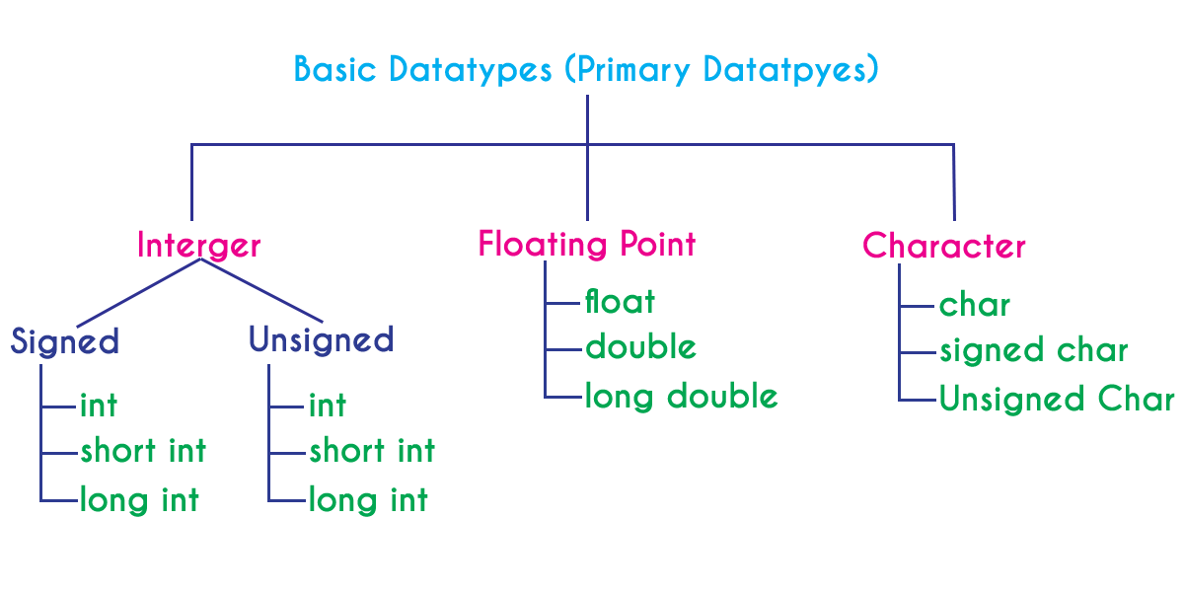
Data Types
Data type is representation of data. Data types specifies
What type of data is allowed to store?
How much memory is required to allocate?
This determines the type and size of data associated with variables. Following are the four data types:
Primitive or Primary data types
Derived data types
User-defined data types
Pointer data types

Slide 48
Data Types
i.Character Types:
Character is used to denote a character type value between single quotations.
The details of character types with their storage sizes and value ranges
1.signed allows both positive (+ve) and negative (-ve) values.
2.unsigned allows only positive (+ve) values.
3.default data type is signed.
Type | Storage size | Value range | Example
char | 1 byte | -128 to 127 | char gender = ‘F’;
unsigned char | 1 byte | 0 to 255 | unsigned char gender = ‘M’;
signed char | 1 byte | -128 to 127 | signed char decision = ‘Y’;

Slide 49
Data Types
ii.Integer Types:
Integer type is used to denote an integer type values.
The details of integer types with their storage sizes and value ranges
Type | Storage size | Value range | signed declarations: short a; (or) short int a; (or) signed short a; (or) signed short int a; unsigned declarations unsigned short a; (or) unsigned short int a;
short | 2 bytes | -32,768 to 32,767
unsigned short | 2 bytes | 0 to 65,535
int | 2 bytes/ 4 byes | -32,768 to 32,767 / -214,74,83,648 to 214,74,83,647
unsigned int | 2 bytes / 4 bytes | 0 to 65,535 / 0 to 429,49,67,295
long | 8 bytes | -9223372036854775808 to 9223372036854775807
unsigned long | 8 bytes | 0 to 18446744073709551615

Slide 50
Data Types
iii.Floating-Point Types:
floating data type is used to denote a floating-point type values.
The details of floating-point types with storage sizes and value ranges and their precision
Type | Storage size | Value range | Precision
float | 4 byte | 3.4E-38 to 3.4E+38 | 6 decimal places
double | 8 byte | 1.7E-308 to 1.7E+308 | 14 decimal places
long double | 10 byte | 3.4E-4932 to 1.1E+4932 | 19 decimal places

Slide 51
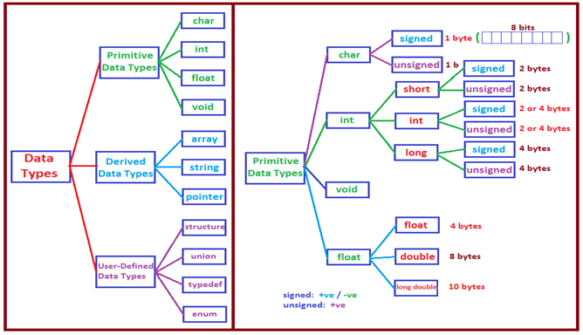
Data Types

Slide 52
1.Single Variable declaration
2.Single Variable initialization
char gender;
signed char gender;
unsigned char gender;
short y;
signed short data;
unsigned short;
float sgpa;
int x = 935;
float avg = 82.90f;
char gender = ‘M’;
long distance = 36467;
short height = 48;
double population = 234.125231;
Syntax:
data_type variable_name = value;
3.Multiple variable declaration
4.Multiple variable initialization
Syntax
data_type variable1, variable2;
Syntax
data_type variable-1 = value, variable-2 = value, variable-3 = value…..;
int x, data, sum;
float avg, cgpa;
char gender, decision;
int x = 342, data = -9122, sum;
float avg = 78.99f, cgpa = 82.84f;

Slide 53
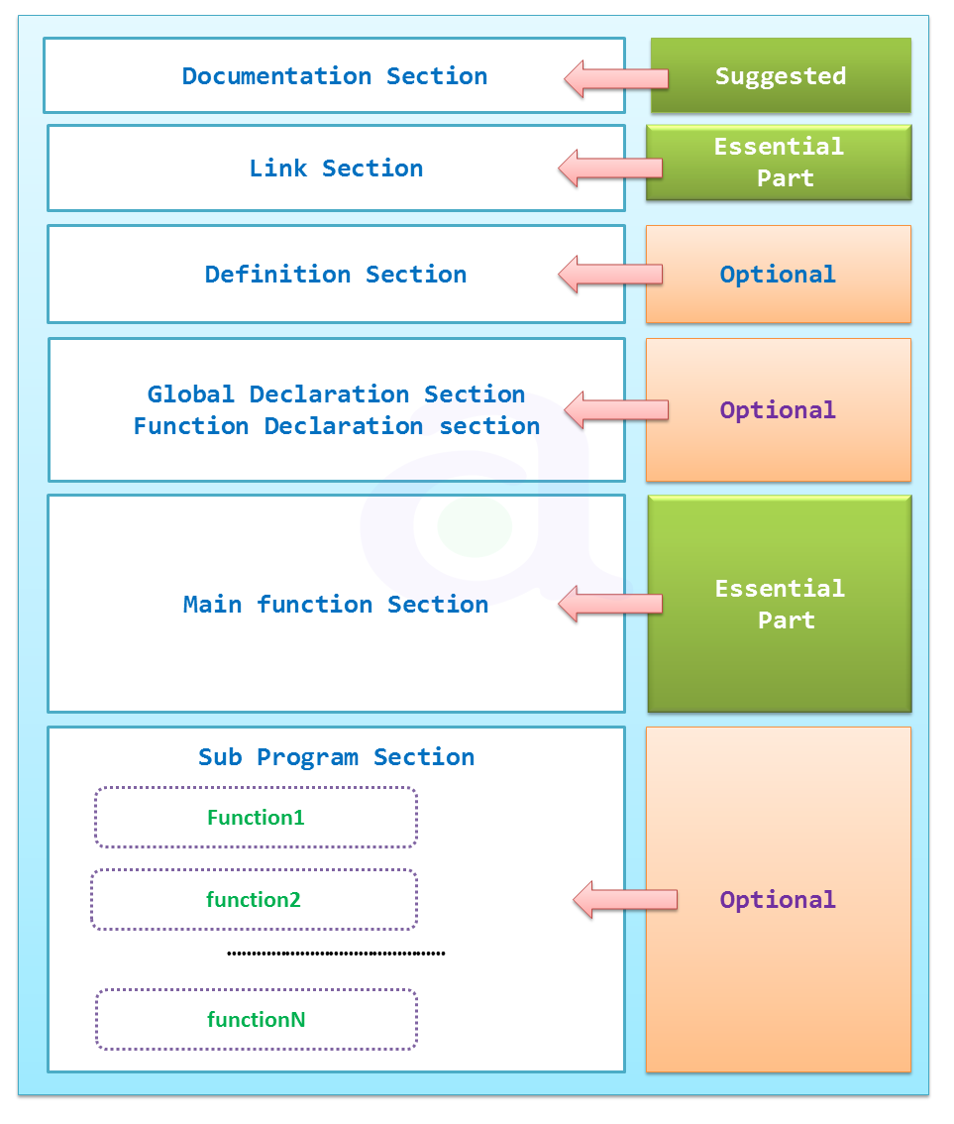
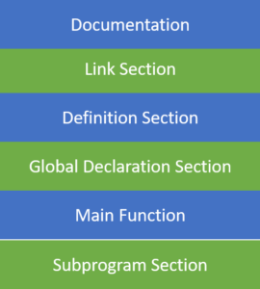
Structure of a c program
A C program is divided into different sections. There are six main sections to a basic c program.

Slide 54
Structure of a c program
1.Documentation Section:
Here the programmer gives the name or aim of the program known as comment.
Comment line provide clarity to the C source code and allowing others to understand. Better
These are 2-Types:
1.Single line comment 2.Multi line comment
Syntax
//………………………………………
Syntax
/*………………………………………
……………………………………..*/
Example
// sample c program
Example
/* sample c
program */

Slide 55
Structure of a c program
2.Link Section:
This part of the code is used to declare all the header files that will be used in the program.
This leads to the compiler being told to link the header files to the system libraries.
3.Definition Section:
In this section, we define different constants,Macros.
The keyword define is used in this part. Example: #define PI 3.14
Syntax
#include “File Name”
Or
#include <File Name>
Example
#include<stdio.h>

Slide 56
Structure of a c program
4.Global Declaration Section:
This part of the code is the part where the global variables, global functions, global structures are declared.
5.Main Function Section:
Every C-programs needs to have the main ()function. Each main function contains 2 parts.
A declaration part and an Execution part.
The declaration part is the part where all the variables are declared.
The execution part is the part where we have to write the actual logic.
Both the declaration and execution part are inside the curly braces.
The program execution begins from the main() function.
main()
{
……………….
……………….
……………….
……………….
}

Slide 57
Structure of a c program
1.Documentation | /*sample program*/
2.Link | #include<stdio.h>
3.Definition | #define PI 3.14
4.Global Declarations | void show( ); int a = 10;
5.Main function | void main( ) { void show( ); }
6.Subprograms | void show( ) { printf( “%d”,a); }

Slide 58
Format Specifiers
The format specifiers are used in C for input and output purposes.
The compiler can understand that what type of data that we are reading using the scanf() function
The compiler can understand that what type of data that we are printing using printf() function.
Data Type | Format Specifier
Character | %c
Signed integer | %i or %d
Float | %f
Double | %lf
Long double | %Lf
Long | %l or %ld or %li

Slide 59
Basic Output statement
printf():
The printf() is a library function to send formatted output to the screen.
To use printf() in our program, we need to include stdio.h header file.
Printf() can be used for following 3-cases:
To print text message
To print Values
To print text and Values

Slide 60
Basic Output statement
printf():
1.
2.
3.
Syntax
printf(“………………………………………");
Example
printf(“Welcome To C-Programming");
Syntax
printf(“Format Specifier“ , Name of the Variable);
Example
printf(“%i“ , a);
Syntax
printf(“Message and Format Specifier“ , Name of the Variable );
Example
printf(“The result is:%i“ , res);

Slide 61
Basic Input statements
scanf( ):
It is one of the commonly used function to take input from the user.
The scanf( ) function reads formatted input from the keyboard.
It gets the address of variable, and the value entered by the user is stored in that address.
Syntax
scanf(“Format Specifier“ , Address of the Variable);
Example
scanf(“%i“ , &a);

Slide 62
6. Operators
Operators are symbols, which are used to perform a specific operation on data.
Operations are performed on operands.
Operators can be classified into three broad categories, according to the number of operands used. Which are as follows:
i) Unary: It involves the use of one a single operand. For instance, ’!’ is a unary operator which operates on a single variable, say ‘c’ as !c which denotes its negation or complement. | a + +; Operands: a Operator: ++
ii) Binary: It involves the use of 2 operands. They are further classified as: a)Arithmetic b)Relational c)Logical d)Assignment e)Bitwise f)Conditional | x + y; Operands: x, y Operator: +
iii) Ternary: It involves the use of 3 operands. For instance, ?: Is used in place of if-else conditions. | x = (a>b) ? a : b ; Operands: a>b, a, b Operator: ?:

Slide 63
6. Operators
An operator is a symbol that operates on a value or a variable.
It tells the computer to perform some mathematical or logical manipulations.
Operators are classified into 8-categories ,they are:
1. Arithmetic operators | These are used to perform mathematical calculations like addition, subtraction, multiplication, division and modulus
2. Relational operators | These operators are used to compare the value of two variables.
3. Logical operators | These operators are used to perform logical operations on two variables.
4. Bitwise operators | These operators are used to perform bit operations on given two variables.
5. Increment/ Decrement operators | These operators are used to either increase or decrease the value of the variable by one.
6. Assignment operators | These are used to assign the values for the variables in C programs.
7. Conditional/ Ternary operator | Conditional operators return one value if condition is true and returns another value is condition is false.
8. Other operators | &, *, sizeof( ) and ternary operators.

Slide 64
1. Arithmetic operators
Arithmetic operators are used to perform mathematical calculations like addition, subtraction, multiplication, division and modulus on numerical values.
// Working of arithmetic operators
#include <stdio.h>
int main()
{
int a = 9,b = 4;
printf(“\n addition is: %d ", a+b);
printf(“\n Subtraction is: %d ", a+b);
printf(“\n Multiplication is: %d ", a+b);
printf(“\n Division is: %d ", a+b);
printf(“\n Remainder is: %d ", a+b);
}
Arithmetic Operators/Operation Example + (Addition) A+B – (Subtraction) A-B * (multiplication) A*B / (Division) A/B % (Modulus) - gives remainder A%B

Slide 65
2. Relational operators
Relational operators are used to find the relation between two variables. i.e. to compare the values of two variables in a C program.
// Working of relational operators #include “stdio.h”
int main()
{
int a = 5, b = 5;
printf(“\n %d ", a == b);
printf(“\n %d ", a > b );
printf(“\n %d “ , a < b );
printf(“\n %d “ , a != b );
printf(“\n %d “ , a >= b );
printf(“\n %d “ , a <= b );
}
Operators | Example/Description
> | x > y (x is greater than y)
< | x < y (x is less than y)
>= | x >= y (x is greater than or equal to y)
<= | x <= y (x is less than or equal to y)
== | x == y (x is equal to y)
!= | x != y (x is not equal to y)

Slide 66
3. Logical operators
These operators are used to perform logical operations on the given expressions. There are 3 logical operators in C language. They are:
// Working of logical operators #include <stdio.h>
int main()
{
int a = 5, b = 5,c=10, res;
res = (a == b) && (c > b);
printf(“\n %d ", res);
res = (a == b) || (c < b);
printf(“\n %d ", res);
res = !(a == b);
printf(" %d \n", res);
}
Operators | Example/Description
&& (logical AND) | (x>5)&&(y<5) It returns true when both conditions are true
|| (logical OR) | (x>=10)||(y>=10) It returns true when at-least one of the condition is true
! (logical NOT) | !((x>5)&&(y<5)) It reverses the state of the operation

Slide 67

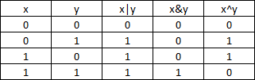
4. Bitwise operators
Bitwise operators are used to perform bit operations at bit level.
Decimal values are converted into binary values which are the sequence of bits and bit wise operators work on these bits.
bit-wise operators | Truth table for bit wise operation
& – Bitwise AND | – Bitwise OR ~ – Bitwise NOT ^ – XOR << – Left Shift >> – Right Shift

Slide 68
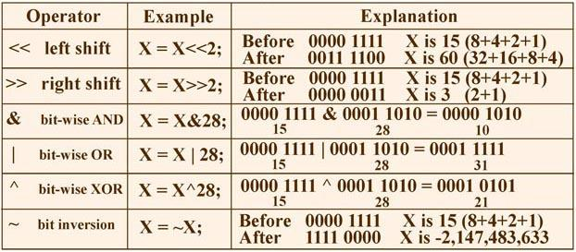
4. Bitwise operators
// Working of bit wise and operator
#include <stdio.h>
int main()
{
int a = 15, b = 28;
printf(“Result is = %d", a&b);
}
Output:
10

Slide 69
5. Increment/Decrement operators
Increment operators are used to increase the value of the variable by one.
decrement operators are used to decrease the value of the variable by one.
Example:
int m=5, n; n=++m; n=6 and m=6
int m=5, n; n=m++; n=5 and m=6
// Working of increment operators
#include “stdio.h”
int main()
{
int a = 5, b ;
b=++a;
printf(“\n %d ", a);
printf(“\n %d ", b);
}
Syntax
++var_name; (or) var_name++;
Example
++i; i++;
Syntax
- - var_name; (or) var_name - -;
Example
- - i; i - -;

Slide 70
6. Assignment operators
In C programs, values for the variables are assigned using assignment operators.
There are 2 categories of assignment operators in C language. They are, 1. Simple assignment operator 2. Shorthand assignment operators
// Working of assignment operators
#include <stdio.h>
int main()
{
int a = 5, c;
c = a;
printf("c = %d\n", c+=a);
}
Operators | Example/Description
= | sum = 10; 10 is assigned to variable sum
+= | sum += 10; This is same as sum = sum + 10
-= | sum -= 10; This is same as sum = sum – 10
*= | sum *= 10; This is same as sum = sum * 10
/= | sum /= 10; This is same as sum = sum / 10
%= | sum %= 10; This is same as sum = sum % 10
&= | sum&=10; This is same as sum = sum & 10

Slide 71
7. Conditional (Ternary) operator
Conditional operators verify the if condition is true it evaluates the expression-1 and if the condition is false then it evaluates the expression-2.
// Working of conditional operators
#include<stdio.h>
main()
{
int n;
printf("Enter any number");
scanf("%d",&n);
(n%2 == 0) ?printf("Even"):printf("Odd");
}
Syntax
(Condition) ? Expression-1 : Expression-2 ;
Example
(a > b) ? Printf(“a is big”) : Printf(“b is big”);

Slide 72
8. Other operators
some of the special operators.
#include <stdio.h>
int main()
{
int a;
float b;
double c;
char d;
printf(“%i",sizeof(a));
printf("%d ",sizeof(b));
printf("%i",sizeof(c));
printf("%d",sizeof(d));
}
Operators | Description
& | This is used to get the address of the variable. Example : &a will give address of a.
* | This is used as pointer to a variable. Example : * a where, * is pointer to the variable a.
sizeof( ) | This gives the size of the variable. Example : size of (char) will give us 1. printf(“%d”, sizeof(short)); 🡪 2

Slide 73

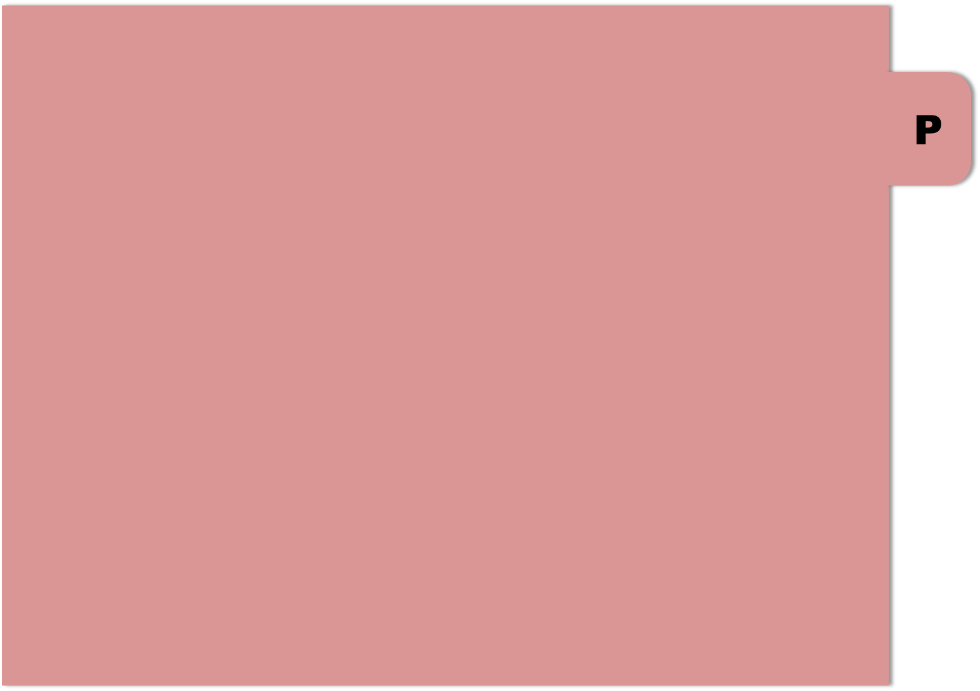

THE END
Notes:
‹#›

